Slide 1
Male engagement works to improve HIV services uptake among men
Reaching men: Yes we can!
Thabiso Lekhotsa, E. Tumbare, V. Tukei, B. Oguntoyinbo, MG. Mefane, M. Mputsoe, F. Mohai

Slide 2
Presentation Outline
Background
Why do we need men’s friendly health clinics?
Data from men’s health clinics
Challenges and proposed solutions
Lessons learned
Next steps

Slide 3
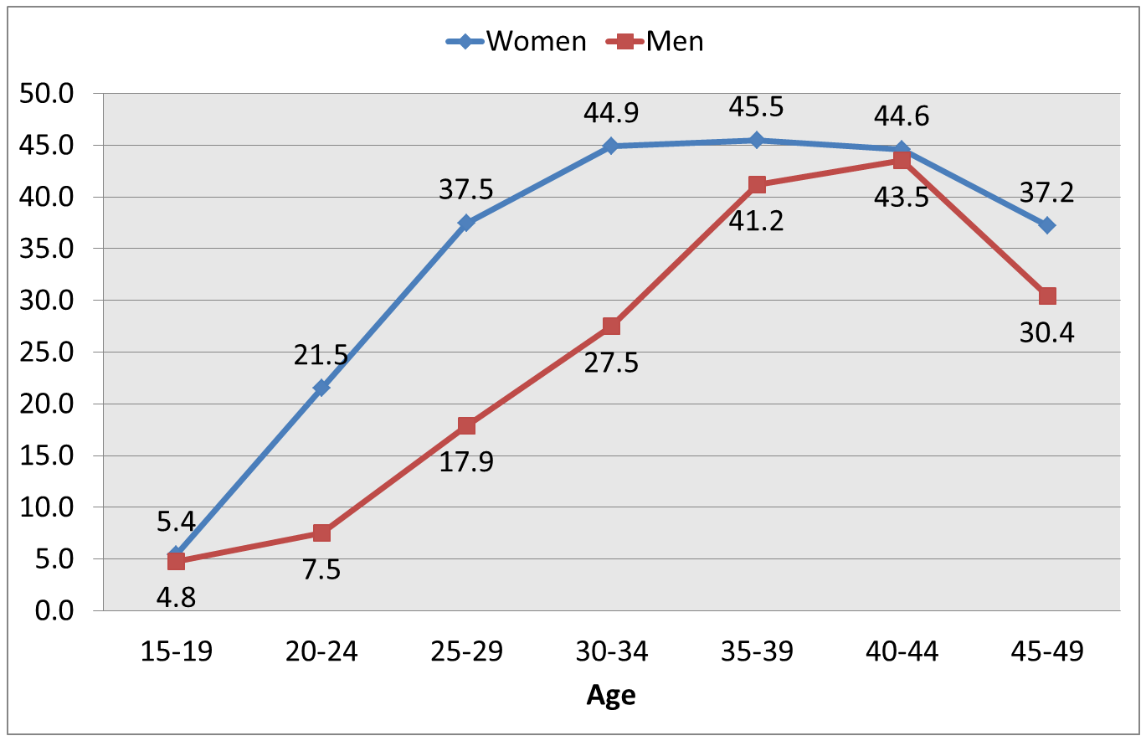
Background
Lesotho has the second highest prevalence of HIV worldwide; it is the country’s leading cause of death.
Adult incidence and prevalence are high: 52 new infections occur daily; 25.6% of adults (ages 15-59) are living with HIV.
Older men are believed to be driving the HIV epidemic among adolescent girls and young women (HIV incidence 15-49 years for men is 2.1% compared to women at 1.7%)
HIV prevalence by age and gender (LDHS, 2014)
LDHS 2014, LePHIA, 2017; MOH 2016 ART Guidelines.

Slide 4
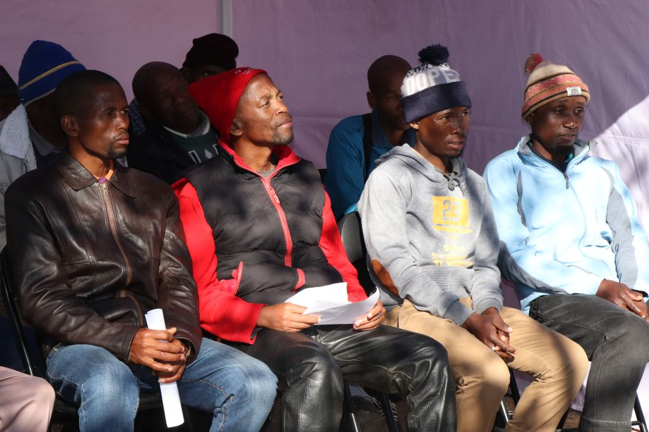
Why do we need male-friendly health clinics?
Only 71% of HIV-positive men know their status, compared to 81% of HIV-positive women
Men often present late with advanced disease and higher mortality rates.
Most health workers are female
Men often find the environment at health facilities more “women and child friendly”
Health facilities only provide services during business hours
Community health services are available when men are at work
There are long lines at facilities, which is challenging for working men
Di Carlo: 2014; Galdas: 2005; Lubega et al: 2015
Notes:
(>65% OPD attendees are women)

Slide 5
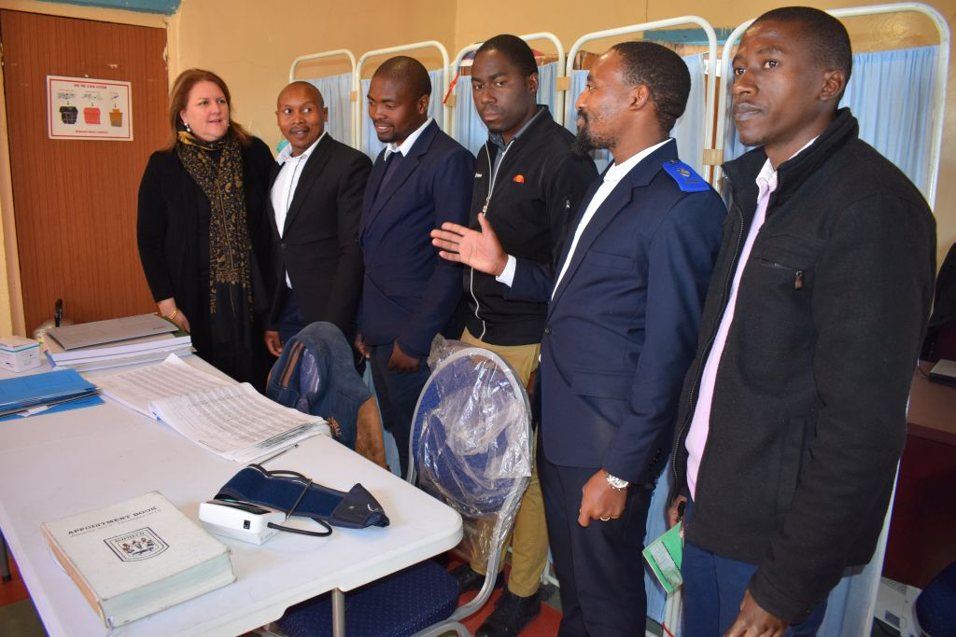
EGPAF male-friendly services approach
EGPAF in collaboration with Lesotho’s Ministry of Health, sought to:
Address barriers to men’s accessing health services
Provide dedicated clinic areas for men in spaces where they felt more comfortable receiving services
Provide services during morning, evening, and weekend hours to make it easier for employed men
Provide appointments to reduce long wait times for men
Notes:
Men working longer day hours and perhaps cannot wait in long lines at clinics

Slide 6
EGPAF’s approach toward reaching men
Focus group discussions were conducted April 2017 and June 2017
Seven, public, high-volume health facilities located at high-transit places were selected to provide male-friendly services.
Male nurses and counsellors were hired and trained to provide:
STI screening and treatment
HIV prevention (PrEP/PEP), testing, care, and treatment
Screening and treatment of opportunistic infections and other co-morbid conditions
Relationship counselling and condom distribution
Education on PMTCT and family testing including partners of pregnant women
Referrals for voluntary medical male circumcision
Counselling on penile and prostrate cancer
Community outreach was conducted through radio programs, community partners, and index testing

Slide 7
Testing Results Before (Jan-Mar 2016) and After (Jul-Sep 2017) Introduction of Men’s Health Corners by Age

Slide 8
Treatment Results Before (Jan-Mar 2016) and After (Jul-Sep 2017) Introduction of Men’s Health Clinics by Age

Slide 9
Adult Male ART Initiation Trends, Relative to Pre- and Post-Treatment for All and Men’s Clinics (October 2015 – Sep 2017) for Seven Facilities

Slide 10
Challenges and Proposed Solutions
Challenges
Limited space for dedicated men-only clinic areas
Few male nurses
Solutions
Dedicated days for men at facilities that do not have male nurses
Targeted outreach for demand creation, and increase accessibility of services among hard-to-reach men
MOH to advocate for training of male nurses and counsellors

Slide 11
Lessons Learned
Providing male-focused services is a welcomed initiative among men in Lesotho
The number of men tested at the health facilities where men’s clinics are located has increased since establishment
Pre-ART men are now accessing ART through the men’s clinics

Slide 12
Next Steps
Scale-up men’s clinics to additional health facilities is underway
The Ministry of Health is leading a scale-up plan to reach more men with HIV testing, prevention, care, and treatment services
Increased index testing / partner identification for women on ART is needed to identify more men in need of testing services
There is also a need to continue training and mentoring male health care workers on provision of male-friendly services at all sites

Slide 13
Acknowledgements
The activities described here were made possible by the United States Agency for International Development (USAID) and the generous support of the American people through USAID Cooperative Agreement No. AID-674-A-16-00005 and through Cooperative Agreement U2G GH001457 funded by the U.S. Centers for Disease Control and Prevention. The content included here is the responsibility of EGPAF and does not necessarily represent the official views of these donors.

Slide 14
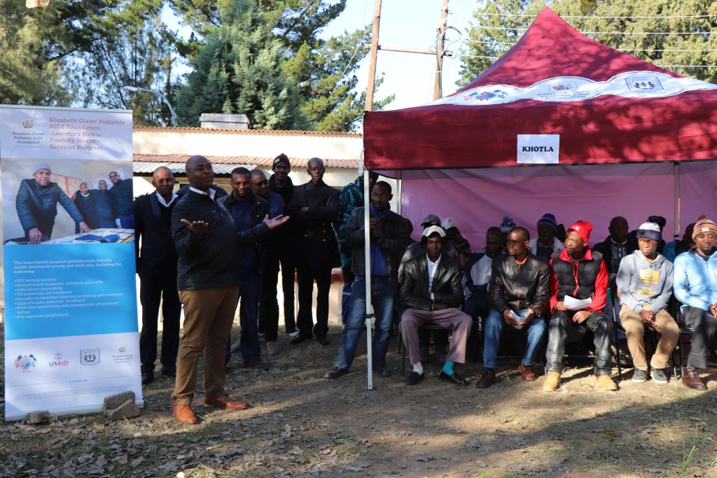
THANK YOU

